Slide 1
Curious Questions
Do people with sleep disorders show different patterns in daily steps or heart rate?
Are certain occupations linked to worse sleep or higher stress?
How do stress levels relate to sleep duration or sleep quality?
Audience:
People who want to understand how lifestyle factors affect sleep and stress.
Communication Goal:
To Improve understanding of how daily habits connect to sleep health.

Slide 2
Mini update #1: This dataset has 374 rows and 13 columns.
Column Name | Missing Values? | Data Type | Useful? | Needs Cleaning?
Person ID | No | Discrete (int) | Maybe | No
Gender | No | Categorical | Yes | No
Age | No | Numeric | Yes | No
Occupation | No | Categorical | Yes | Maybe
Sleep Duration | No | Numeric | Yes | No
Quality of Sleep | No | Numeric | Yes | No
Physical Activity Level | No | Numeric | Yes | No
Stress Level | No | Numeric | Yes | No
BMI Category | No | Categorical | Yes | No
Blood Pressure | No | Categorical | Yes | Maybe
Heart Rate | No | Numeric | Yes | No
Daily Steps | No | Numeric | Yes | No
Sleep Disorder | Yes (219 missing) | Categorical | Yes | Yes

Slide 3
WEEK 1
✨CURIOUS
QUESTIONS✨

Slide 4
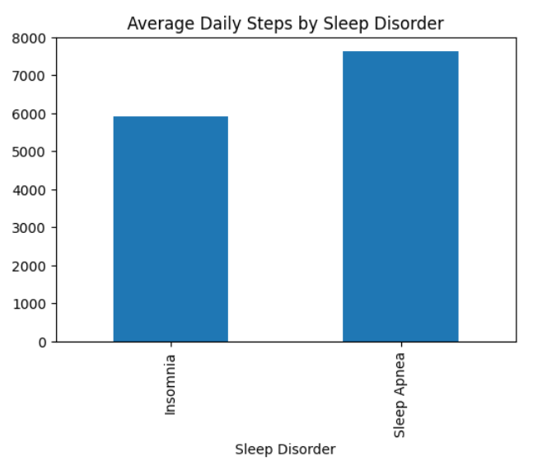
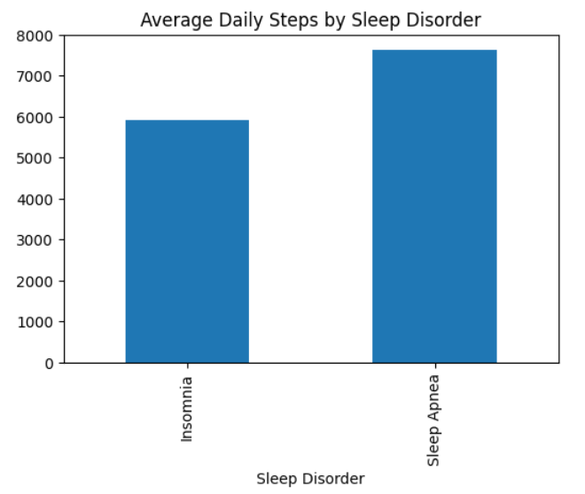
Do people with different disorders show different patterns in steps or heart rate?
Sleep Disorders and Daily Steps
People with sleep apnea walked more on average (about 7,619 steps) compared to those with insomnia (about 5,901 steps). The difference shows that not all sleep disorders affect activity the same way.
CONTRIBUTOR: SHARON AROWOLO

Slide 5
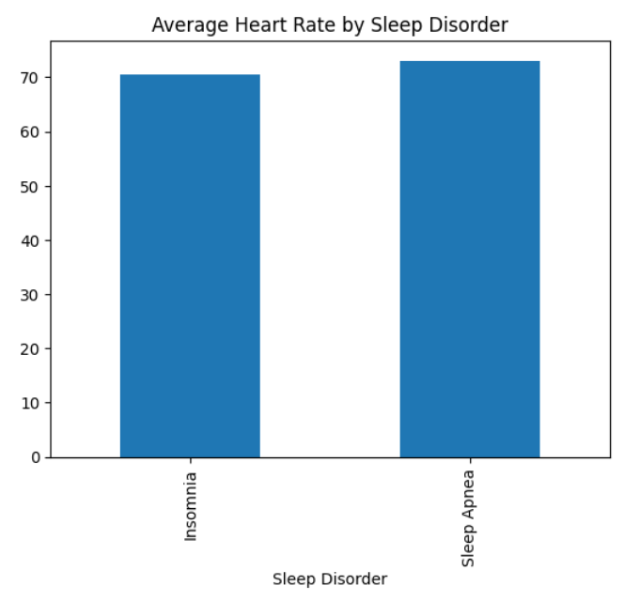
Do people with different disorders show different patterns in steps or heart rate? (Contd)
Sleep Disorders and Heart Rate
Average heart rate was slightly higher for sleep apnea (around 73 bpm) than insomnia (around 70 bpm). This suggests sleep apnea may put a bit more strain on the body.
CONTRIBUTOR:SHARON AROWOLO

Slide 6
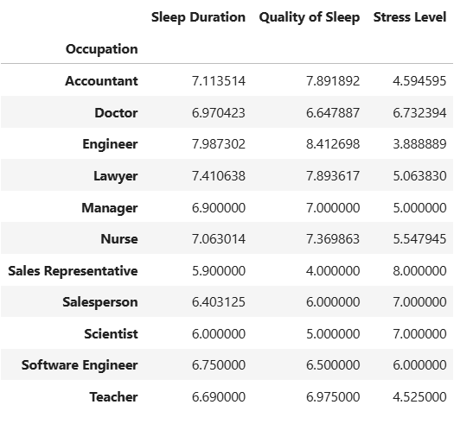
Are certain occupations linked to worse sleep or higher stress?
Occupation, Sleep, and Stress
Different jobs show different sleep and stress patterns. Sales Representatives stand out with the lowest sleep quality (4.0) and the highest stress level (8.0), while Engineers have the best sleep quality (8.41) and one of the lowest stress levels (3.89). This makes it clear that some occupations deal with more pressure than others, and it shows up in their sleep.
CONTRIBUTOR: SHARON AROWOLO

Slide 7
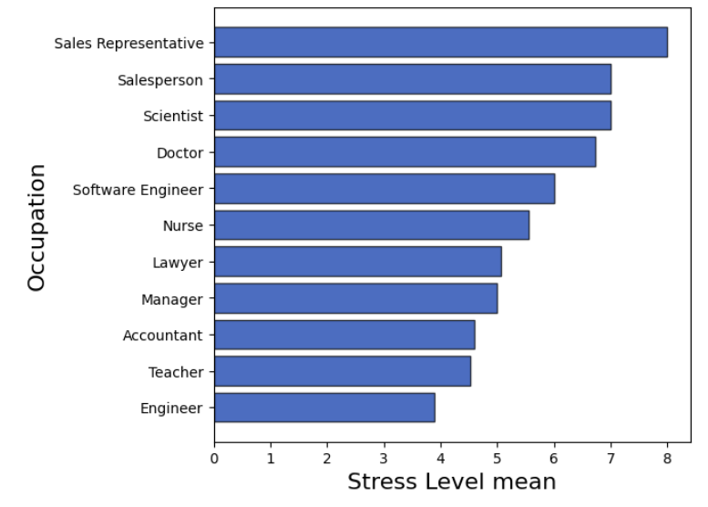
Are certain occupations linked to worse sleep or higher stress?(Contd)
Stress Levels Across Occupations
Stress levels vary a lot by job. Sales Representatives have the highest stress level at 8, while Engineers and Teachers are on the lower end around 4. This shows that some jobs carry way more pressure than others.
Some jobs are clearly more stressful, and it shows in the numbers
CONTRIBUTOR: SHARON AROWOLO

Slide 8
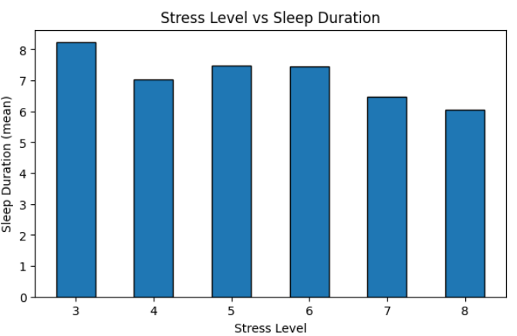
How do stress levels relate to sleep duration or sleep quality?
Stress Level & Sleep Duration
Higher stress levels show a slight trend toward shorter sleep duration. It’s not a perfect pattern, but overall, people with more stress tend to sleep a little less.
CONTRIBUTOR: SHARON AROWOLO

Slide 9
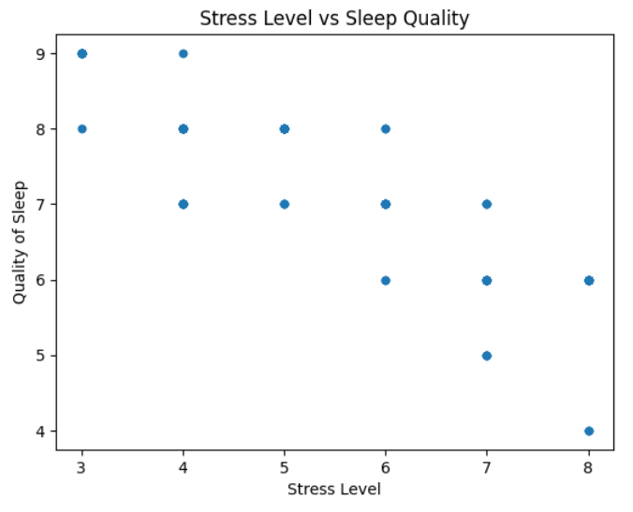
How do stress levels relate to sleep duration or sleep quality?(Contd)
Stress Level & Sleep Quality
Sleep quality drops as stress levels go up. The points aren’t perfectly lined up, but the overall pattern shows that higher stress usually means lower sleep quality.
CONTRIBUTOR: SHARON AROWOLO

Slide 10
Summary of What I Learned This Week
This week helped me understand how different lifestyle factors connect to sleep and stress. I learned that sleep disorders show up in people’s daily steps and heart rate, stress levels affect both sleep duration and sleep quality, and occupations have their own sleep and stress patterns. Breaking each question into its own slide made the patterns clearer and helped me see how the story fits together.

Slide 11
Week 2 Curious Questions
1. Does sleeping longer actually lead to better sleep quality?
2. Do people with higher stress levels tend to have higher heart rates?

Slide 12
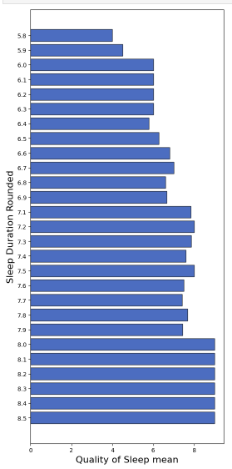
Does sleeping longer actually lead to better sleep quality?
People who sleep longer tend to report slightly better sleep quality on average, although the relationship is not very strong as there might be other factors also plating into their sleep quality.

Slide 13
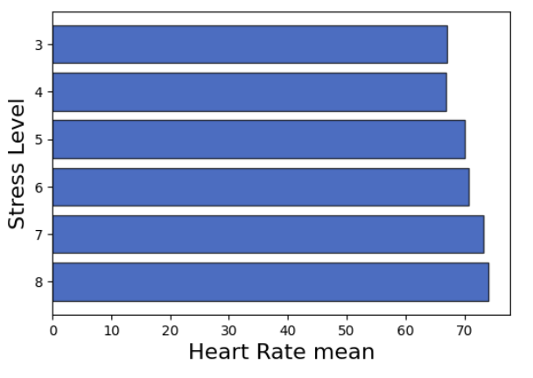
Do people with higher stress levels tend to have higher heart rates?
Higher stress levels are associated with slightly higher average heart rates, according to the data, the higher the stress level, the higher the heart rate. Suggesting that stress may have a measurable effect on the body.

Slide 14
What i learned this week
This week, I learned how to analyze relationships in my dataset using grouping, sorting, and clear visualizations. I practiced comparing variables like stress, sleep duration, sleep quality, heart rate, and sleep disorders, and I learned when to switch from scatterplots to bar charts for clearer results. I faced a few obstacles, including charts not displaying, bars being too close together, and missing values breaking my plots. I fixed these issues by adjusting my plotting methods, using horizontal bar charts or matplotlib for better spacing and resetting the plotting backend when Jupyter stopped showing graphs. Overall, I became more confident in troubleshooting my code and choosing the right visualizations to clearly explain my findings.

Slide 15
Week 3 Curious questions
Do people with higher physical activity levels take more daily steps?
Does age group affect stress levels?

Slide 16
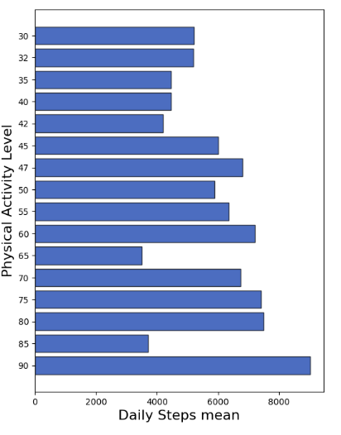
Do people with higher physical activity levels take more daily steps?
The chart shows a clear upward trend: people with higher physical activity levels take more daily steps on average. The bars increase steadily as activity level rises, which highlights a strong relationship between movement and overall activity intensity. This pattern suggests that individuals who are more active throughout the day naturally accumulate more steps.

Slide 17
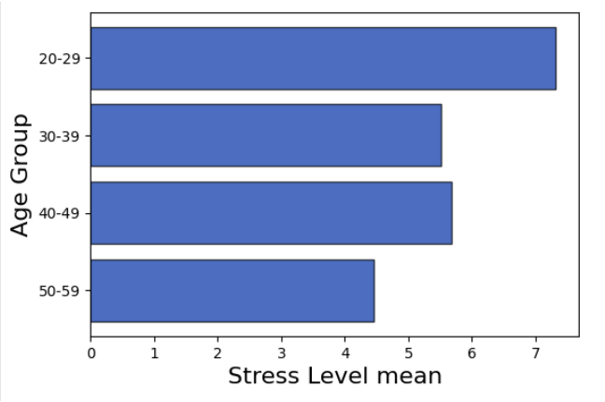
Does age group affect stress levels?
The chart shows that younger adults tend to have higher average stress levels than older adults. The 20–29 age group has the highest stress, while stress gradually decreases across the older age groups. This pattern suggests that stress may be more common or more intense in early adulthood compared to later stages of life.

Slide 18
What i learned this week
This week, I learned how to analyze relationships in my dataset by grouping variables and comparing their averages through clear visualizations. I explored patterns such as younger adults having higher stress levels, higher physical activity levels being linked to more daily steps, and stress levels rising alongside heart rate. While working through these questions, I encountered a few obstacles, especially with creating age groups and getting some charts to display correctly. I overcame these challenges by checking my column names, fixing data types, and adjusting my approach until the visualizations came out clean. Overall, this week taught me how to interpret grouped data more confidently, recognize meaningful trends in health‑related variables, and troubleshoot issues in a structured way.

Slide 19
WEEK 4
MICRO
STORY

Slide 20
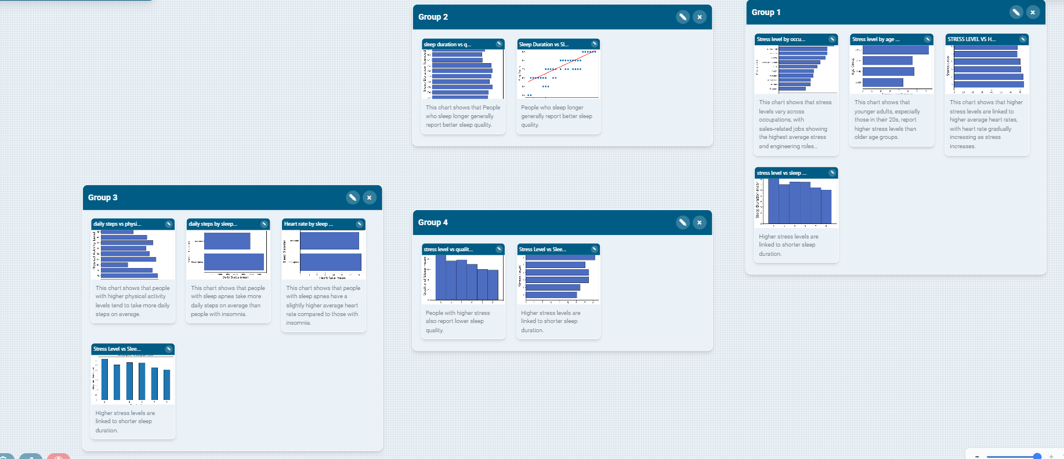
HOW DOES STRESS AFFECT SLEEP?

Slide 21
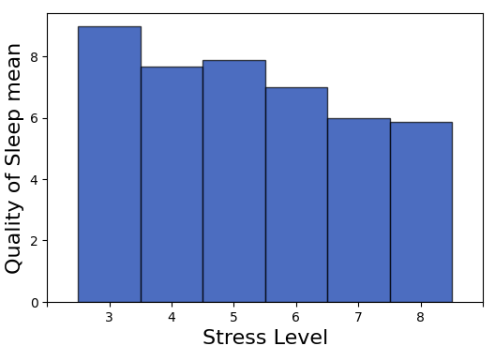
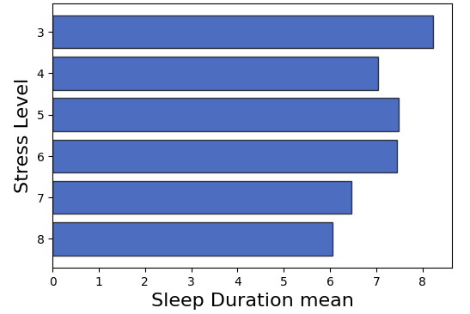
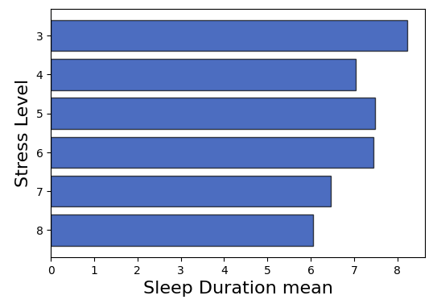
HOW DOES STRESS AFFECT SLEEP?

Slide 22
Micro-Story Draft
The story I chose shows the relationship between stress levels and average sleep durationand sleep quality. It shows that as stress increases, the amount of sleep people get drops which also affects their sleep quaality. I know this because the bars clearly decrease from low stress to high stress, which means people with higher stress are sleeping fewer hours. This pattern stood out to me because it connects two things that affect almost everyone: stress and sleep. I’ve definitely had days where stress made it harder to sleep, so seeing the data match my own experience made it feel more real.
This dataset matters to me because I’m a student, and stress is something I deal with all the time. When I don’t sleep enough, everything feels harder, focusing, remembering things, even just getting through the day. So looking at this chart made me think about how much stress affects my daily routine without me even noticing.
I think this dataset should matter to other people because it shows how connected our habits and health really are. A lot of people think stress is just a mental thing, but this chart shows it affects sleep, which then affects everything else. Understanding this could help people take stress more seriously.
Notes:
Try adding the personal relations to the beginning of the story and take out all the (my story is about) it distracts people from the story and make the first sentence something everyone can relate to. Like a “have you ever?” “I have” kinda beginning (draw your listeners in). You can also add how different occupations play a role in stress levels and maybe find a solution even if you can’t plot a graph. Also maybe add a ‘how less sleep makes me feel like i’m out of my body and watching myself perform tasks as habits not as me actually doing things’.

